Slide 1

Part II Prosper Loan Dataset
by Ashley Self

Slide 2
Investigation Overview
For this presentation, I decided to focus on a few variables to see if they determine whether a consumer will default on their loan. A few variables I focused on were: Listing Category, Stated Monthly Income, Loan Status, Prosper Score, Monthly Loan Payment, and Employment Status. I did explore a few visuals for Debt-to-Income Ratio, but because the data had quite a few outliers, and it was more spread out than the other variables, I decided not to pursue any comparisons with DTI.

Slide 3
Dataset Overview
The data in this file contains information for 113,937 loans with 81 variables (columns) on each loan (row), including, but not limited to: loan origination date, listing category (numeric), term, borrower rate, monthly loan payment, prosper score, loan status, estimated loss, employment status, stated monthly income, debt to income ratio, delinquencies in the last 7 years, and borrower state. These are the 13 variables that I chose to focus on in my exploration.

Slide 4

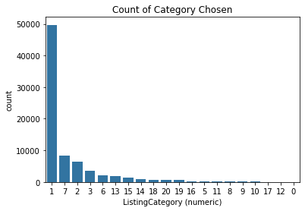



Count of Listing Category Chosen (desc.)
Most borrowers selected "Debt Consolidation" (Category 1) as their reasoning behind applying for a Prosper loan.
The second highest reason borrowers chose when applying for a loan was "Other" (Category 7).
Categories 0 (Not Available), 12 (Green Loans), and 17 (RV) do not seem to be selected at all according to these charts.

Slide 5
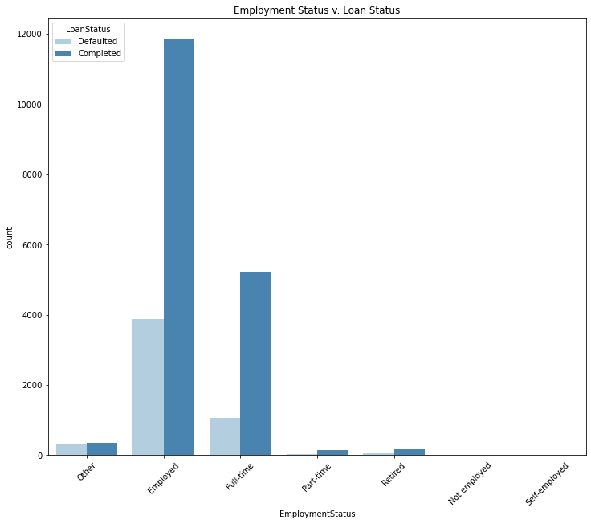
Employment Status v. Loan Status
From this visualization we can correlate that those who have chosen 'Employed' as their employment status are three times more likely to complete their loan than default. Employed status also has the highest number of completed loans over all other employment statuses chosen.

Slide 6
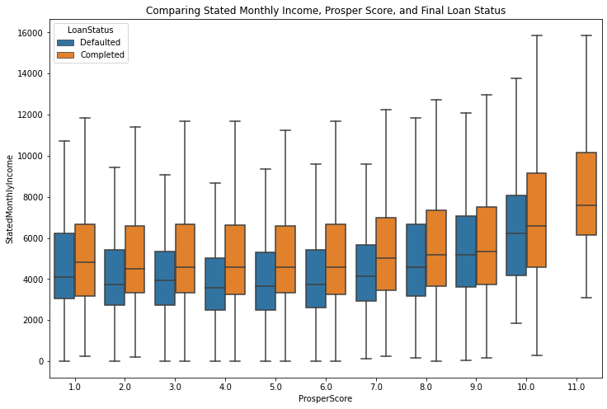
Comparison Visual Stated Monthly Income v. Prosper Score v. Loan Status
We see a slight upward trend in that the higher a consumers stated monthly income is, the more likely they will complete their loan instead of defaulting in this visual.
Although, across the board, more loans were completed no matter what prosper score was given, it does show a correlation between stated monthly income and loan status (i.e.: no matter the score, if a consumer stated lower monthly income on their application, they have a higher risk of defaulting on the loan.
There is a bigger gap between median stated monthly income from score 1.0 - 7.0: we see from score 8.0 - 10.0 the median income gap starts to get smaller, almost the same for score 9.0.

Slide 7
Conclusion
My initial thought that most consumers applied for loans through Prosper because of debt was correct as 'Debt Consolidation' was the highest chosen listing category, even though the average Debt to Income Ratio was between 10% - 20%, which I don't believe to be too high. It was pleasantly surprising, however, to see that most loans in the dataset were labeled as 'current’!
My conclusion is that the Prosper Score system needs an overhaul as it seems to be accurate with certain variables, and not accurate with others. There needs to be a better, more complete, scoring system in place to be fair to consumers as to whether their applications are approved or denied based on more than a handful of variables. One way to do this would be to compare DTI to more than just one or two other variables, maybe a complete comparison of every variable/column listed before I cleaned it up to only include 13.

